Slide 1
Introduction
Computer analysis of seismicity can yield statistical information that may aid in earthquake forecasting by revealing patterns to their formation
The software uses moving window analysis to aggregate this information from subsets of events in time (one dimension) or in space (two dimensions)
A and B values were collected using least squares regression and maximum likelihood analysis

Slide 2
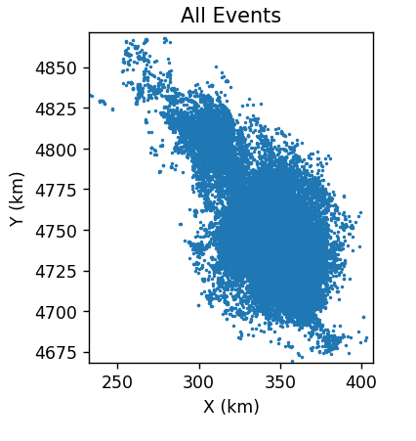
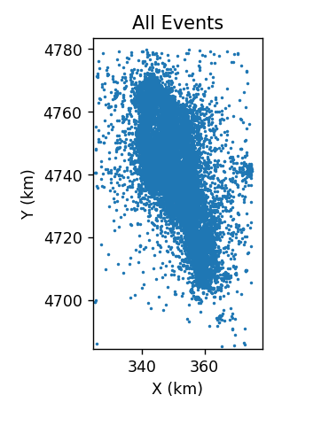
Data Overview and Filtering
Analysis of the Amatrice earthquake catalogue with temporal and spatial moving windows
Magnitude of completeness: 2
Cropping:
X: [325, 375]
Y: [4680, 4780]
Z: [-100, ∞)

Slide 3
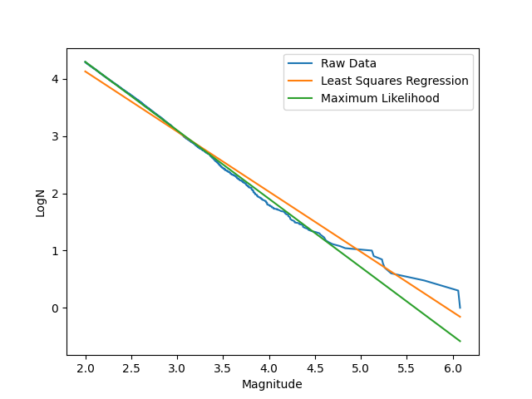
Magnitude vs Logged Event #
A-value:
Y-intercept
B-value:
Slope

Slide 4
Window Settings
Bin size: 0.2 (default)
Temporal
Sliding windows of size 500 and increment 100
Spatial
Sliding windows of size 5 km and increment 1 km
Minimum event count 500 (default)

Slide 5
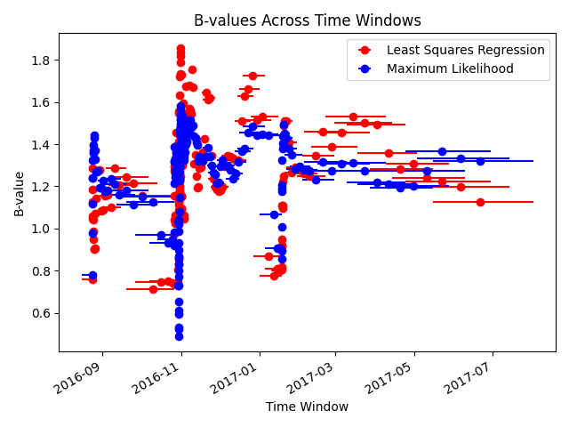
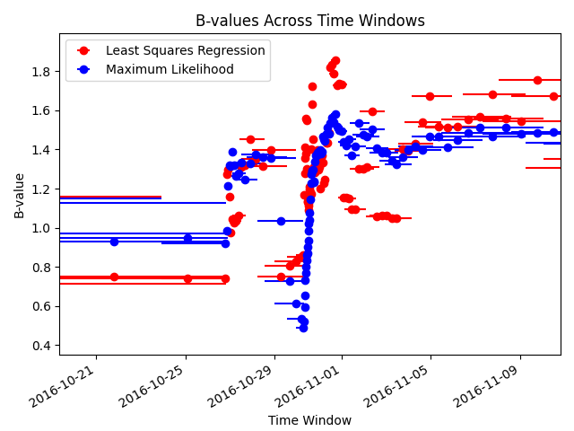
Temporal Sliding Window
Three periods of elevated seismic activity are seen by the nearly vertical portions of the scatter plot, corresponding to large earthquakes in Amatrice, Visso + Norcia, and L’Aquila respectively
Finer magnification reveals the three day separation between Visso and Norcia events

Slide 6
Temporal Sliding Window (2)
A common trend seen across all periods of elevated seismic activity is that the b-value is at its lowest when a large earthquake occurs and immediately rises following it
There is less variation in b-value over time when there is less seismic activity as seen by the period after January of 2017

Slide 7
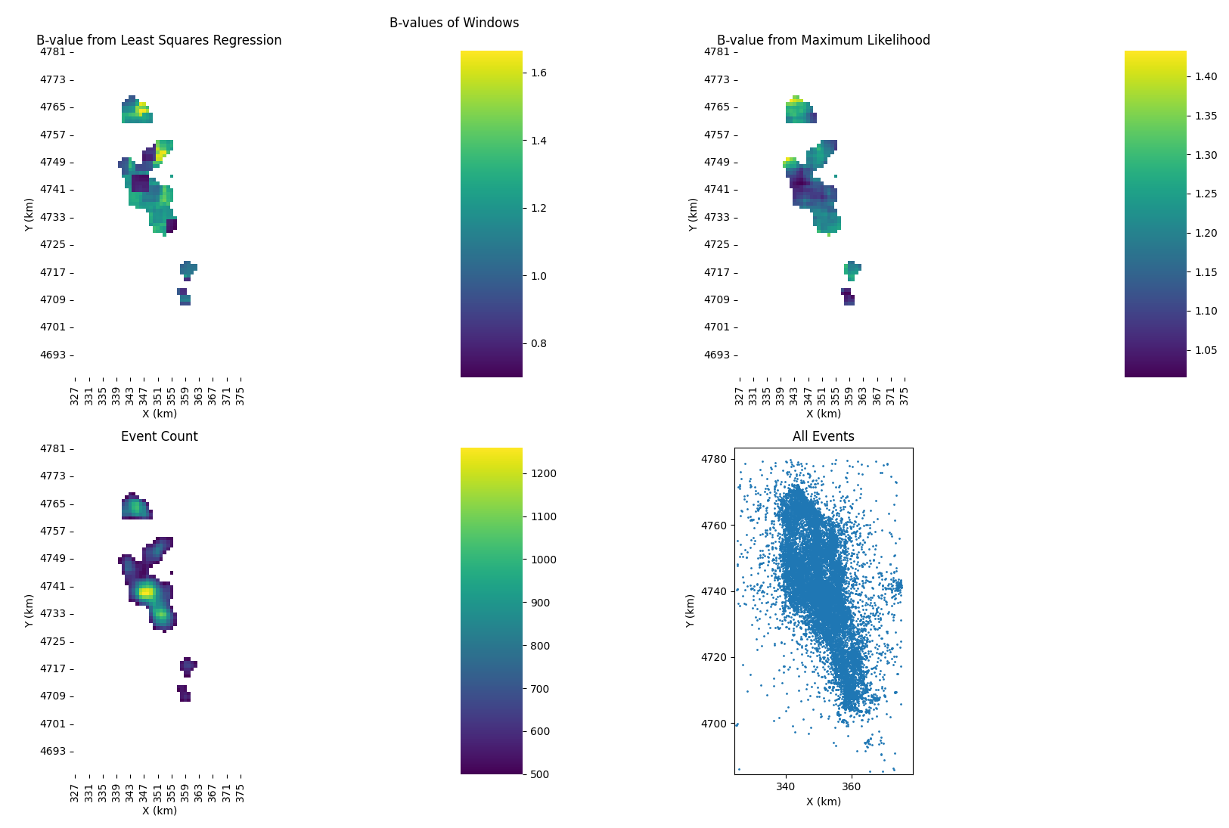
Spatial Sliding Window
The highest density of events as indicated by the brightest yellow spot correspond to seismic activity around Norcia
A smaller yellow spot to its southeast corresponds to seismic activity around Amatrice

Slide 8
Spatial Sliding Window (2)
There may be a relationship between event density in space and b-value however it is not immediately visible with the window settings tested so far
Some areas have above or below average b-values with LSR or ML analysis but these areas do not correspond exactly to the areas with the highest event density

Slide 9
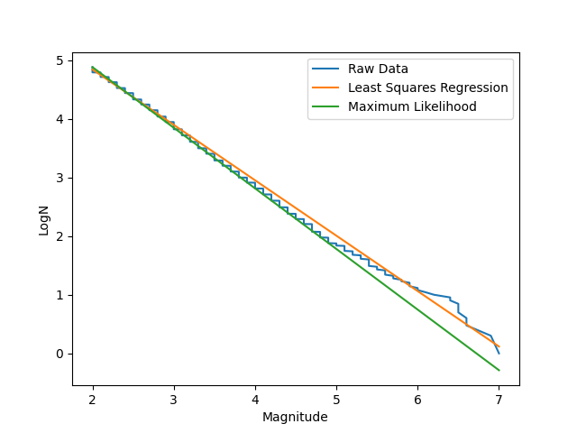
Comparison with North California
DD84.txt North California dataset
Magnitude of completeness: 2
Cropping:
X: [300, 1000]
Y: [3900, 4550]
Z: [-40, ∞)
Bin size: 0.2 (default)
Temporal
Sliding windows of size 500 and increment 100
Spatial
Sliding windows of size 40 km and increment 8 km
Minimum event count 500 (default)

Slide 10
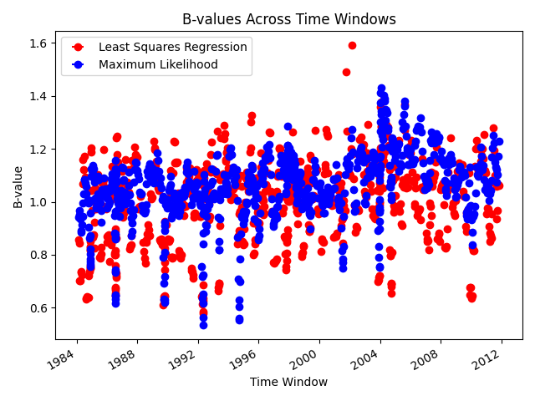
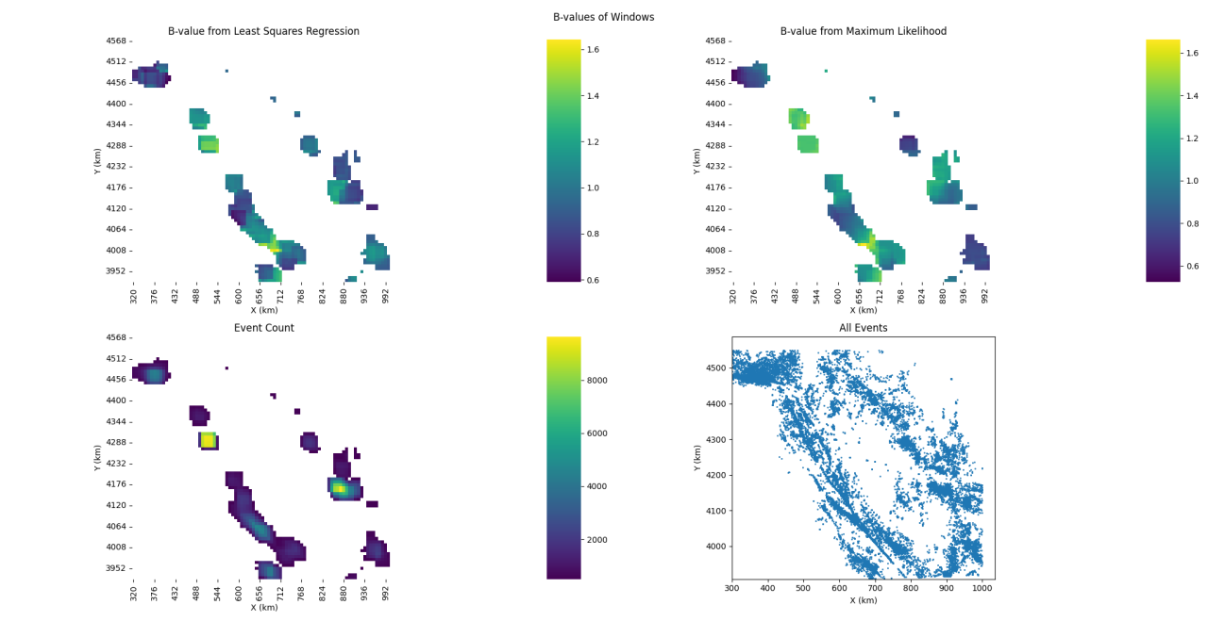
Comparison with North California (2)
Similar b-value rise observed when events of high magnitude occur (again)
Inconclusive relationship with space and b-value visually (again)

Slide 11
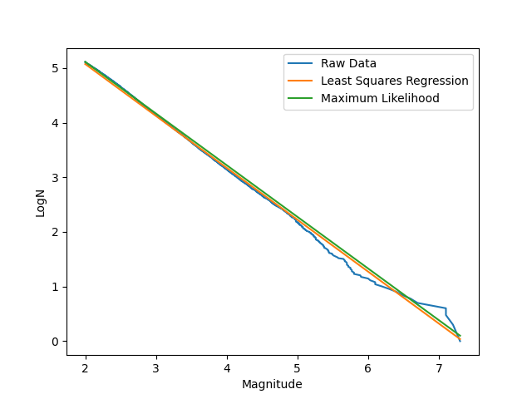
Comparison with South California
HaukssonCalifAll.txt South California dataset
Magnitude of completeness: 2
Cropping:
X: [100, 700]
Y: [3480, 4160]
Z: [-20, ∞)
Bin size: 0.2 (default)
Temporal
Sliding windows of size 500 and increment 100
Spatial
Sliding windows of size 25 km and increment 5 km
Minimum event count 500 (default)

Slide 12
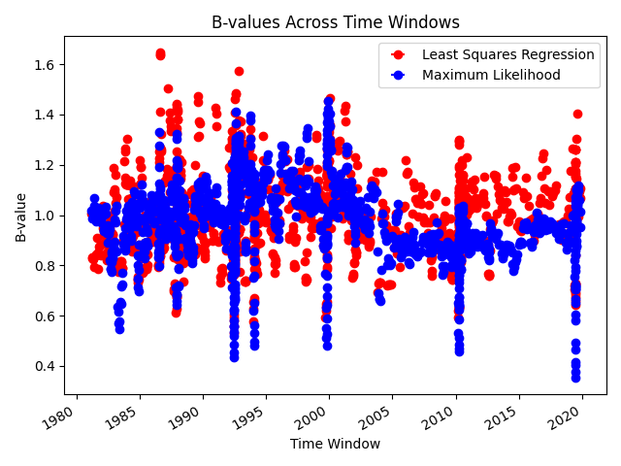
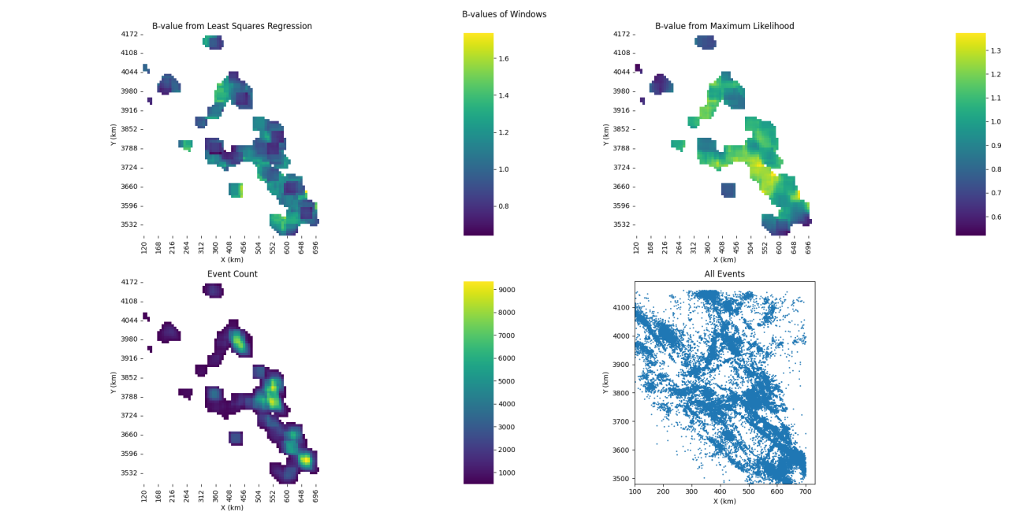
Comparison with South California (2)
Similar b-value rise observed when events of high magnitude occur (again)
Inconclusive relationship with space and b-value visually (again)

Slide 13
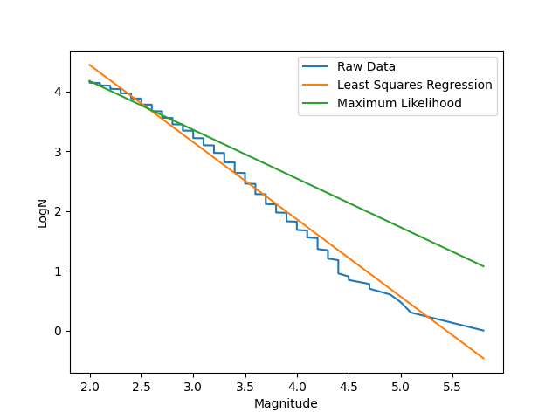
Comparison with Oklahoma
SRL_2017083_esupp_Table_S1.csv Oklahoma dataset
Magnitude of completeness: 2
Cropping:
X: [480, 730]
Y: [3910, 4130]
Z: [-10, ∞)
Bin size: 0.2 (default)
Temporal
Sliding windows of size 500 and increment 100
Spatial
Sliding windows of size 25 km and increment 5 km
Minimum event count 500 (default)

Slide 14
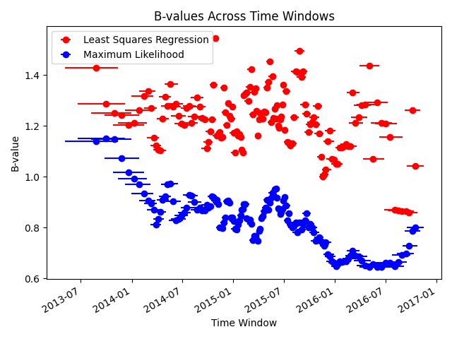
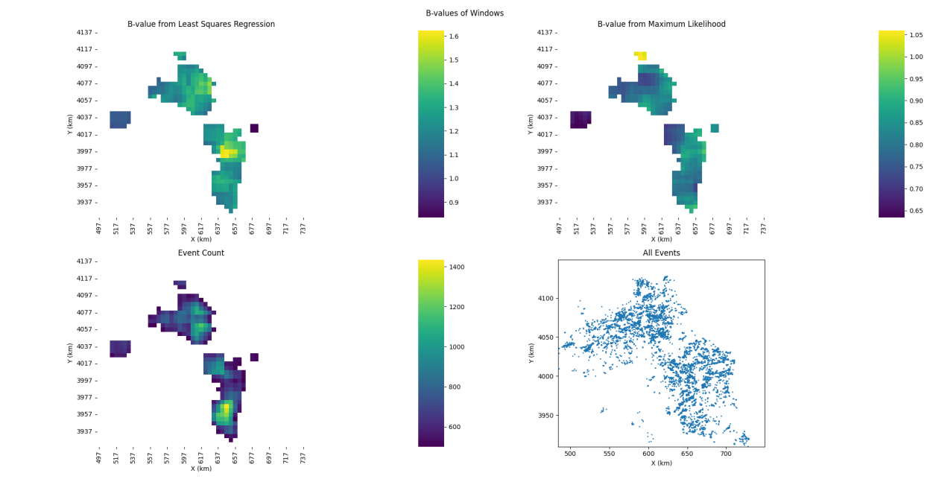
Comparison with Oklahoma (2)
No rapid increase in b-value compared to other datasets observed
Inconclusive relationship with space and b-value visually (again) but closer to inverse relationship

Slide 15
Conclusion
Strongest trend visible in data is that b-values rise when large events occur on tectonic boundaries (Italy and California)
Further analysis needed to determine if prior b-values predict large events and the relationship between b-values in spatial windows and seismicity
Possible extensions to improve the software include increasing window dimensionality by combining analysis in time and space as well as considering variability in the depth (Z dimension) of events
Shapes different from squares, or even entirely different techniques such as clustering, may also yield better results

